Slide 1

Heart Disease Diagnostic- Analysis
By: Shilpa Nagpal

Slide 2

Introduction
Heart disease remains one of the leading causes of mortality worldwide, affecting individuals across all demographics regardless of socioeconomic status. By leveraging data from a heart disease diagnostic database, this report aims to conduct an in-depth analysis of heart disease rates, distribution by gender and age, and explore various attributes associated with heart health.. As it is rightly said, ‘Health is Wealth’. We have realized this fact in the pandemic time after witnessing the brute effects of Covid-19 on people of all age groups. Apart from this, another major contributor to the death rate is heart-related diseases. Heart diseases have been known to take a major toll on people’s lives. As a layman, we may feel that the common factors for heart-related diseases are cardiac arrest or blockages. But the dataset under analysis describes multiple different medical parameters associated with the heart and their typical values. We will be analyzing the relationships between them and studying the implications of changes in those parameters. In this project, we will be incorporating the most trending and powerful BI tool namely Tableau.

Slide 3

Problem Statement
Health is real wealth in the pandemic time we all realized the brute effects of covid-19 on all irrespective of any status. You are required to analyze this health and medical data for better future preparation.
Do ETL: Extract- Transform and Load data from the heart disease diagnostic database.
You can perform EDA through python. The database extracts various information such as Heart disease rates, Heart disease by gender, by age. You can even compare attributes of the data set to extract necessary information. Make the necessary dashboard with the best you can extract from the data. Use various visualization and features and make the best dashboard Find key metrics and factors and show the meaningful relationships between attributes. Do your own research and come up with your findings.
PROJECT TITLE | Heart Disease Diagnostic Analysis
TECHNOLOGY | Data Science
DOMAIN | HealthCare
PROJECT DIFFICULTY LEVEL | Intermediate
PROGRAMMING LANGUAGE USED | Python
TOOLS USED | Jupyter Notebook, MS-Excel, Tableau

Slide 4

Architecture
Raw data Collection
Modelling
Tableau Public Desktop
Importing Libraries in Jupiter Notebook
Exploratory Data Analysis (EDA)
Insights
Load dataset
Data Cleaning
Reporting
Missing Values imputations
Handling outliers

Slide 5
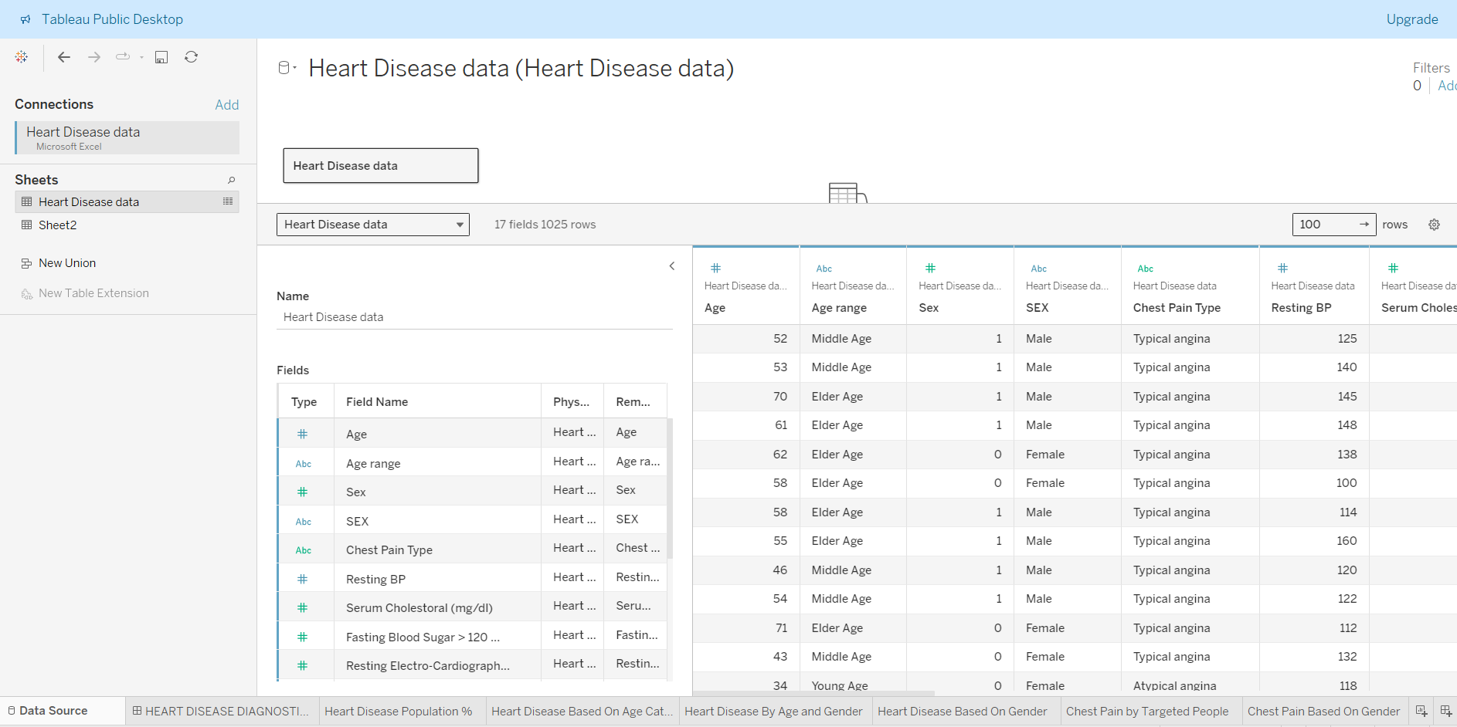
Data Source

Slide 6
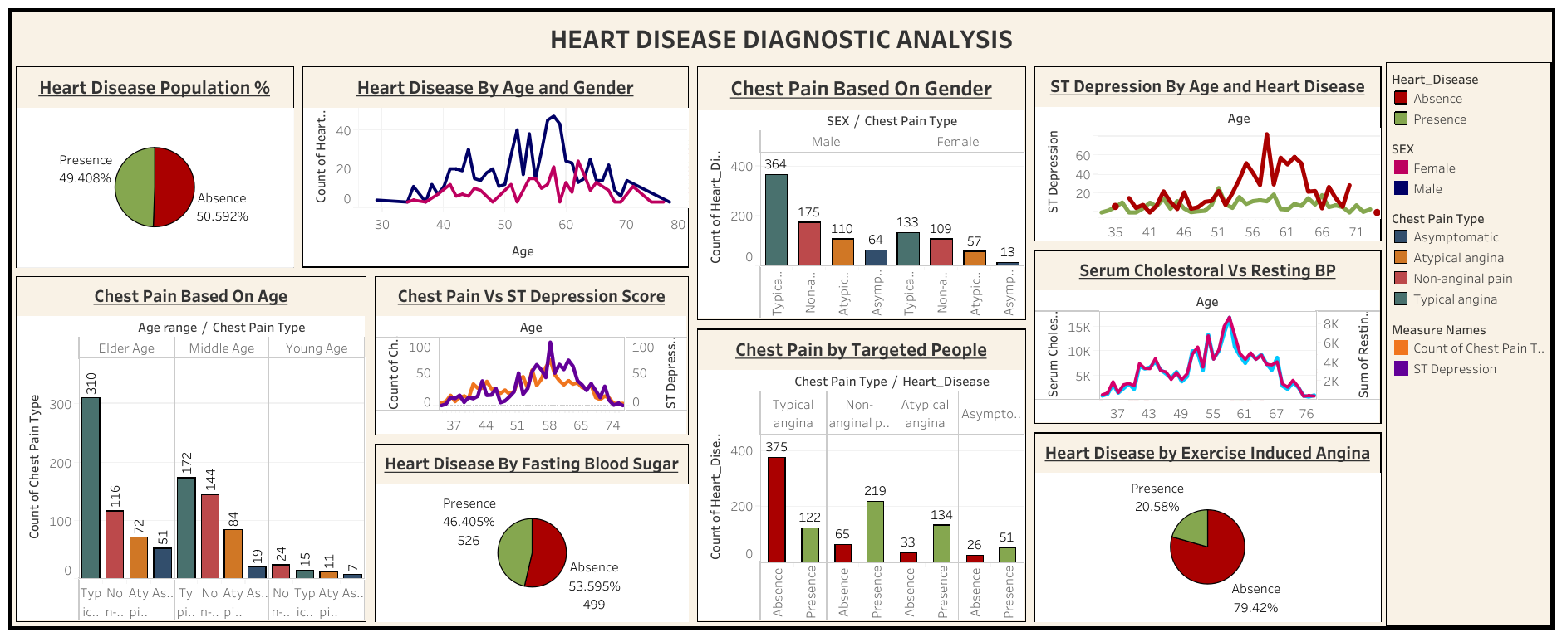
My Dashboard

Slide 7

INSIGHTS
Heart Disease Prevalence: The prevalence of heart disease in the dataset is relatively
high at 51.3%, indicating that heart disease is a significant health concern among the
patients included in the study.
Demographic Distribution: The dataset consists of 312 females and 713 males,
suggesting a higher representation of males. This may indicate either a higher
prevalence of heart disease among males or a higher proportion of males seeking
medical attention for heart-related issues.
Age and Heart Disease: The average age of patients in the dataset is 54 years,
indicating that heart disease affects individuals across a wide age range. However, it
would be beneficial to analyze the age distribution further to understand if there are
specific age groups more susceptible to heart disease.
Resting Blood Pressure and Serum Cholesterol: The average resting blood pressure and serum cholesterol levels are 131 BPM and 246 mg/dl, respectively. Elevated levels of both indicators are associated with an increased risk of heart disease, highlighting the importance of monitoring these parameters for early detection and prevention.
High Fasting Blood Sugar: A concerning finding is the high fasting blood sugar rate of
14.9%. Elevated blood sugar levels are associated with diabetes, which is a significant
risk factor for heart disease. This suggests a potential need for diabetes screening and
management among the patient population.
Max Heart Rate: The maximum heart rate recorded for males (202 BPM) is higher than
that for females (192 BPM). While individual variation exists, this may reflect
physiological differences between genders.
Exercise Induced Angina and Abnormal Resting Electrocardiographic Rate: The
rates of exercise-induced angina (33.7%) and abnormal resting electrocardiographic
findings (51.5%) are both relatively high

